Slide 1




Systematic Evaluation of Signal-to-Image Transformation Pipelines for Vision Transformer-based Sleep Stage Classification
BioMed Frontiers 2026
International Conference on Biomedical Innovation
Paper ID: 45
Janith R.R.H. Ramanayakage and Chandima N.P.G. Arachchige
Department of Statistics, Faculty of Science, University of Colombo, Sri Lanka

Slide 2




Why automate sleep staging?
BioMed Frontiers 2026 | International Conference on Biomedical Innovation
Sleep disorders (insomnia, apnoea, narcolepsy) are widespread
1–3 h
82.6%
Gold standard: manual scoring of polysomnography (PSG)
to score one full-night recording
inter-scorer agreement, experienced experts
Slow and subjective: hours per night; experts disagree
50–70 M
US adults living with a sleep disorder
Deep learning: CNN/RNN → Vision Transformers (ViTs)
Two scoring standards
R&K: Wake, S1, S2, S3, S4, REM (used here)
AASM: W, N1, N2, N3, R (S3 + S4 merged)

Slide 3


Research gap and objectives
BioMed Frontiers 2026 | International Conference on Biomedical Innovation
The gap
Four experiments
Prior ViT work uses spectrograms or raw signals only
GASF, GADF and MTF never compared for ViTs
Best sampling rate before imaging unknown
Pre-training value on PSG images unclear
1
Image transformation: GASF, GADF, MTF, spectrogram
2
Sampling rate: 512 / 256 / 128 / 64 Hz, FFT vs DWT
3
Pre-trained vs from-scratch ViT, balanced vs imbalanced
4
Seven architectures incl. ResNet-50 baseline

Slide 4
Dataset: CAP Sleep Database
BioMed Frontiers 2026 | International Conference on Biomedical Innovation
80
80,667
recordings (6 healthy, 74 patients)
30-second epochs
16
6
channels at 512 Hz
stages: Wake, S1–S4, REM
Subject-wise 5-fold CV: no subject in both train and test

Slide 5
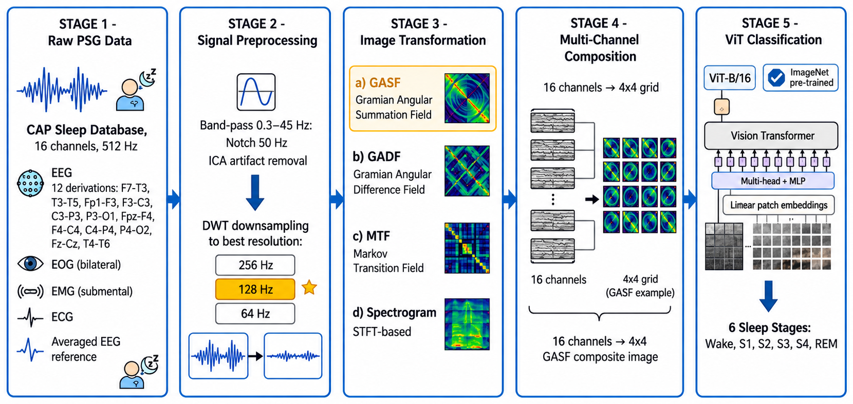
Proposed Pipeline
BioMed Frontiers 2026 | International Conference on Biomedical Innovation
Figure 1. Overall five-stage pipeline

Slide 6




Four Signal-to-Image transformations
BioMed Frontiers 2026 | International Conference on Biomedical Innovation
GASF
GADF
MTF
Spectrogram
Gramian Angular Summation Field
Gramian Angular Difference Field
Markov Transition Field
STFT, Hamming 256
Summed angles; preserves global temporal correlation
Difference of angles; less globally coherent
32 bins; quantisation loss, slow (5 s/epoch)
Fixed time–frequency resolution
16 images → 4×4 grid → 224×224×3 → ViT-B/16

Slide 7
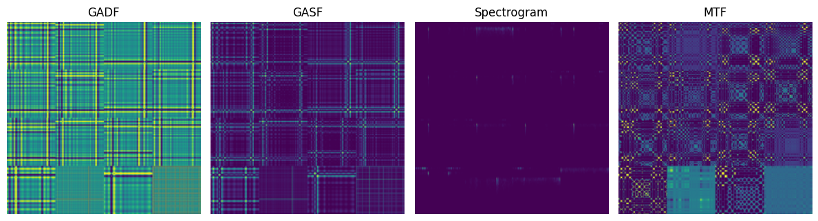
Same epoch, four images
BioMed Frontiers 2026 | International Conference on Biomedical Innovation
One subject, one 30 s epoch, original 512 Hz: 16 channels tiled into a 4×4 composite
Angle difference
Angle sum
Time–frequency (STFT)
Transition probabilities
The encoding changes the texture the ViT sees; GASF keeps rich structure

Slide 8
GASF performs best
BioMed Frontiers 2026 | International Conference on Biomedical Innovation
EXPERIMENT
78.5%
GASF accuracy (macro-F1 0.773)
5.0 s
MTF time per epoch vs 0.2 s for GASF
GASF ≈ GADF; both clearly beat MTF and spectrogram

Slide 9
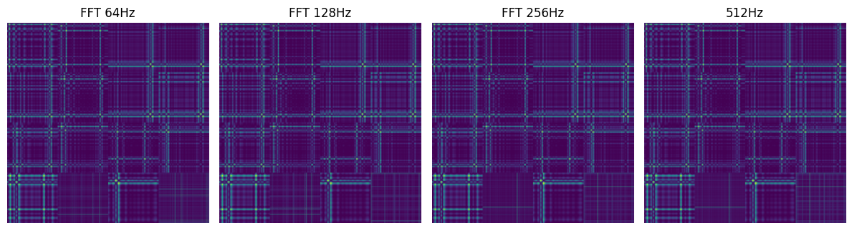
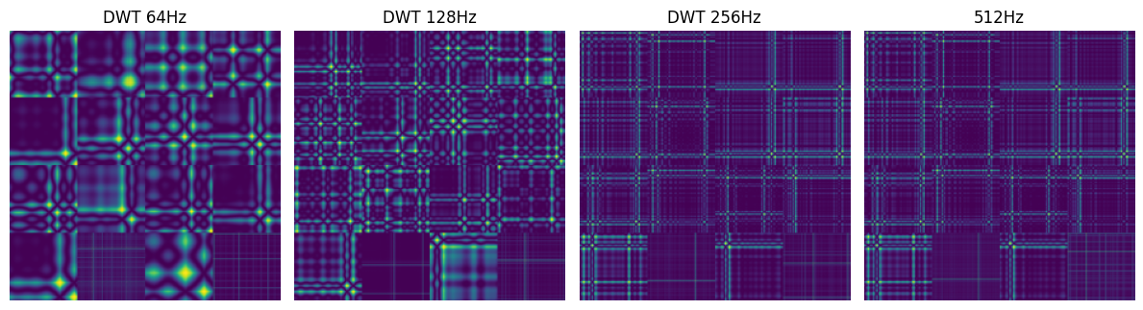
Downsampling: FFT vs DWT
BioMed Frontiers 2026 | International Conference on Biomedical Innovation
What to look for
GASF images of the same epoch, resampled to 64, 128, 256 Hz and the 512 Hz original.
FFT: image structure stays almost the same at every rate.
DWT: images change visibly below 256 Hz; 128 Hz is the sweet spot for accuracy (next slide).
FFT
DWT
Same epoch, same GASF encoding; only the resampling method differs

Slide 10
DWT at 128 Hz is optimal
BioMed Frontiers 2026 | International Conference on Biomedical Innovation
EXPERIMENT
80.3%
DWT @ 128 Hz (macro-F1 0.791)
+1.8 pp
over original 512 Hz signals
DWT beats FFT at every reduced rate; peak at 128 Hz

Slide 11
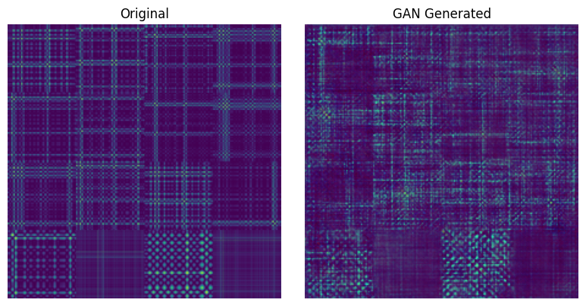
Class balancing with DCGAN
BioMed Frontiers 2026 | International Conference on Biomedical Innovation
How it works
A DCGAN learns the GASF composites of each under-represented class.
Synthetic images are added to training folds only.
Test folds stay 100% real, so there is no leakage.
Real GASF composite vs DCGAN-generated sample, same class
Synthetic samples keep the 4×4 channel layout and balance the classes

Slide 12
Pre-training adds 11+ points
BioMed Frontiers 2026 | International Conference on Biomedical Innovation
EXPERIMENT
+11.4 pp
balanced: 86.2% vs 74.8%
+12.2 pp
imbalanced: 80.5% vs 68.3%
Balancing (DCGAN, training folds only) adds ≈ 5.7 pp

Slide 13
ViT-B/16 beats other models
BioMed Frontiers 2026 | International Conference on Biomedical Innovation
EXPERIMENT
86.2%
ViT-B/16 (macro-F1 0.853)
+10.0 pp
over ResNet-50 CNN baseline
Transformers outperform the CNN; PVT-Small is the efficient option

Slide 14

Class-wise results and limitations
BioMed Frontiers 2026 | International Conference on Biomedical Innovation
Limitations
S1 (6.5% of data) is weakest
Single database; no cross-dataset test
R&K labels, not AASM
No formal significance tests
4×4 channel layout not ablated

Slide 15




Conclusions and future work
BioMed Frontiers 2026 | International Conference on Biomedical Innovation
Best pipeline
Future work
GASF image encoding
Multimodal fusion
DWT resampling to 128 Hz
Lightweight ViTs for edge use
Fine-tuned ImageNet ViT-B/16
Cross-dataset validation
86.2% accuracy, 0.853 macro-F1

Slide 16

Thank you
BioMed Frontiers 2026
International Conference on Biomedical Innovation
Paper ID: 45
Questions?
janithramanayake523@gmail.com
Code on GitHub

